Slide 1

Exploring Risk Factors in PDAC Using System Dynamics
Ashiat Ashake Adeogun & Misagh Faezipour
College of Basic and Applied Sciences, Healthcare Informatics & Department of Engineering Technology, Middle Tennessee State University, Murfreesboro, Tn, United States.
Email:aaa2ev@mtmail.mtsu.edu, misagh.faezipour@mtsu.edu
The 2023 World Congress in Computer Science, Computer Engineering, & Applied Computing (CSCE'23)
International Conference on Health Informatics & Medical Systems (HIMS’23)
Systems
Engineering Lab (SEL)

Slide 2

Outline
01
Introduction
Pancreatic Cancer
02
Problem formulation
Risk Factors in PDAC
03
Methodology
System Dynamics Modelling
04
Proposed Solution
The casual loop for the complex interactivity of pancreatic cancer risk factors
05
Conclusion
Summary & Conclusion
Systems
Engineering Lab (SEL)

Slide 3
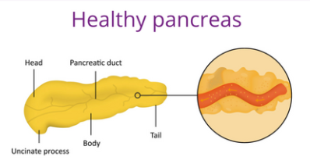


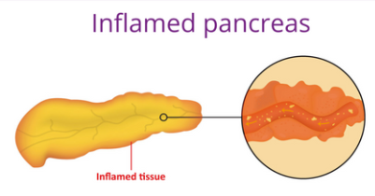


Pancreatic Cancer
Pancreatic cancer is a type of cancer that affects the pancreas, which is a small organ located behind the stomach in the abdomen. The pancreas plays a crucial role in digestion and regulating blood sugar levels by producing enzymes and hormones, including insulin.
Pancreatic cancer is the term used to describe pancreatic ductal adenocarcinoma (PDAC) and is the fourteenth most prevalent cancer among people globally. In the United States, there were reportedly 95,389 persons living with pancreatic cancer in 2020.
PC is the third most common cause of cancer related mortality, with a 5-year survival rate of only 10%. Its related variations, which make up between 85 and 90% of all pancreatic neoplasms.
Moreover, 64,050 or 3.3% are estimated to have new cases, and 50,550 or 8.3% were estimated to have deaths in 2023.
The high-risk people for pancreatic cancer screening could also be aided by knowing the risk factors, improving the likelihood of an early diagnosis.
Systems
Engineering Lab (SEL)

Slide 4
Risk Factors in PDAC
Given the low survival rate of PDAC, it is critical to determine its underlying causes or risk factors.
There are several individual and environmental factors associated with pancreatic carcinogenesis.
There are modifiable and non-modifiable risk factors for pancreatic cancer; the specific cause of the disease is unknown.
Non-modifiable risk factors are age, gender, ethnicity, ABO blood, and family history
Smoking, alcohol consumption, dietary factors, chronic pancreatitis, obesity, chronic infection, diabetes, and socioeconomic status are all modifiable risk factors.
The most significant recognized environmental risk factor for pancreatic cancer worldwide is cigarette smoking.
Systems
Engineering Lab (SEL)

Slide 5
Modifiable Risk Factors of PDAC
Modifiable risk factors can be changed or modified through lifestyle choices, interventions, or treatments.
Modifiable Risk Factors:
Smoking
Obesity
Diabetes
Dietary Habits
Alcohol Consumption
Chronic Pancreatitis
Systems
Engineering Lab (SEL)

Slide 6
Modifiable Risk Factors of PDAC
Smoking is strongly correlated with an increased risk of pancreatic cancer, with long-term smoking and higher daily cigarette consumption amplifying this risk. While smoking is a significant factor, it is not the sole cause of pancreatic cancer, as other factors also contribute to its development.
Obesity is strongly associated with a higher incidence of pancreatic cancer and is likely to worsen outcomes for this disease. Multiple studies have consistently found a link between obesity and an increased risk of pancreatic cancer, with individuals in the highest quartile of body mass index (BMI) having a 1.33 times higher risk compared to those in the lowest quartile.
Long-standing diabetes is associated with an elevated risk of developing pancreatic cancer. Research indicates that individuals with type 2 diabetes who have had the condition for ten years or more are more likely to develop pancreatic cancer.
Systems
Engineering Lab (SEL)

Slide 7
Modifiable Risk Factors of PDAC
High intakes of oil, fat, meat, and dairy products have been linked to an increased risk of pancreatic cancer and digestive disorders/cancers (30–50%)). Conversely, adopting healthy dietary habits can help lower the risk. Saturated and trans fats and red and processed meats may contribute to cancer development through mechanisms such as inflammation.
High alcohol intake (over three daily drinks) consistently links to increased pancreatic cancer risk. No evidence suggests low-to-moderate consumption poses a higher risk. Damage to pancreatic cells and inflammation may contribute to the association.
Long-term chronic pancreatitis is a significant risk factor for pancreatic cancer. While alcohol is a common cause, other factors can also contribute. Recent evidence highlights the association between chronic pancreatitis and increased pancreatic cancer risk.
Systems
Engineering Lab (SEL)
Notes:
Diets rich in fruits, vegetables, whole grains, and legumes have been associated with a lower risk of developing pancreatic cancer. These foods are typically high in fiber, antioxidants, vitamins, and minerals, which can have protective effects against cancer.

Slide 8
Non-Modifiable Risk Factors of PDAC
Non-modifiable factors are those that cannot be changed or altered. These factors are typically inherent to an individual.
Non-Modifiable Risk Factors:
Gender
Ethnicity/Race
Family History
Age
Systems
Engineering Lab (SEL)

Slide 9
Non-Modifiable Risk Factors of PDAC
Age: The risk of developing pancreatic cancer increases with age, with more than 80% of cases being diagnosed between the ages of 60 and 80. In the United States, the average age at which pancreatic cancer is detected is typically around 65 to 67 years.
Gender: In 2022, the United States witnessed 25,970 male fatalities and 23,860 female deaths attributed to pancreatic cancer. Additionally, there were 32,970 newly diagnosed cases among males and 29,240 among females. Globally, men have a higher likelihood of developing pancreatic cancer and experiencing fatal outcomes compared to women.
Ethnicity/Race: Pancreatic cancer exhibits racial disparities, with African Americans facing higher rates. Factors like smoking, alcoholism, obesity, high-calorie diets, type 2 diabetes, and lower socioeconomic status contribute to this disparity, emphasizing the need for targeted interventions.
Family History: A family history of pancreatic cancer, especially in a close relative, is associated with an increased risk of developing the disease. About 5% to 10% of individuals diagnosed with pancreatic cancer report having first-degree relatives with a history of the disease.
Systems
Engineering Lab (SEL)

Slide 10

System Dynamics Modeling
In the late 1950s, Jay Forrester invented the problem-oriented modeling technique known as system dynamics modeling to aid business managers in understanding industrial issues.
System dynamics, which attempts to understand system behavior, includes causal mapping and the development of computer simulations.
The application has grown to encompass different fields including:
Ecology and economics
Food industry
Climate dynamics
Moreover, since the 1970s, population health issues have been
using dynamics modeling in various subject areas:
Research on heart disease
Diabetes
Mental health
Tobacco control measures
Systems
Engineering Lab (SEL)
Notes:
System dynamics modeling is used to increase our understanding of a problem. Improve existing systems, improve behaviors, and reduce complexity.

Slide 11
Causal Model
Causal models are used in support of system dynamics in a complex system.
Causal models can graphically illustrate factors and their relationships in a system as causal links.
Risk factors in the PDAC development create a complex environment with the various interrelations between these factors.
They have accompanying signs on these links that indicate an increasing (+) or decreasing (-) relationship.
Systems
Engineering Lab (SEL)

Slide 12
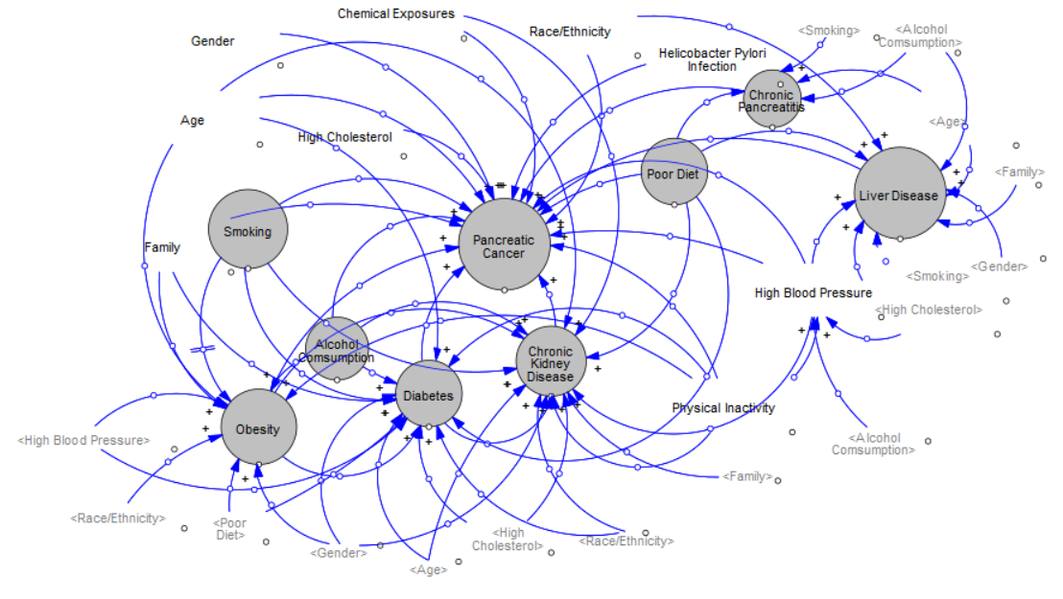
The Casual Loop
Tobacco control measures
The casual loop for the complex interactivity of pancreatic cancer risk factors
Systems Engineering Lab
Notes:
Apparently, The causal loop show the relationship between modifiable and non/modifiable risk factors.
The causal model shows a positive relationship from the age factor the pancreatic cancer factor. Advancing age is a significant risk factor for pancreatic cancer. The risk increases substantially after the of 50, and most cases are diagnosed in individuals over the age of 65.
According to risk estimations, individuals with short-term diabetes face a higher risk of pancreatic cancer than those with long-term diabetes. Two theories suggest reversing causality as the main factor explaining this inverse relationship, particularly for patients with a short duration of diabetes (2 years).
A positive relationship can be seen from the diabetes factor to the pancreatic cancer. Secondly, lifestyle modifications following a diabetes diagnosis or using specific anti-diabetic drugs may have played a role in reducing the risk of pancreatic cancer with prolonged diabetes.
There is a positive relationship from poor diet factor to the pancreatic cancer factor according to the causal model.
Smoking and obesity increase the chance of developing type 2 diabetes mellitus and pancreatic cancer . The relationship from the obesity factor to the pancreatic cancer factor and the smoking factor to the pancreatic cancer is a positive relationship as seen on the loop.

Slide 13
Causal Loop Summary
The causal loop show the relationship between modifiable and non/modifiable risk factors.
The causal model shows a positive relationship from the age factor the pancreatic cancer factor. Advancing age is a significant risk factor for pancreatic cancer. The risk increases substantially after the of 50, and most cases are diagnosed in individuals over the age of 65.
According to risk estimations, individuals with short-term diabetes face a higher risk of pancreatic cancer than those with long-term diabetes. Two theories suggest reversing causality as the main factor explaining this inverse relationship, particularly for patients with a short duration of diabetes (2 years)
A positive relationship can be seen from the diabetes factor to the pancreatic cancer. Secondly, lifestyle modifications following a diabetes diagnosis or using specific anti-diabetic drugs may have played a role in reducing the risk of pancreatic cancer with prolonged diabetes.
There is a positive relationship from poor diet factor to the pancreatic cancer factor according to the causal model. known
Smoking and obesity increase the chance of developing type 2 diabetes mellitus and pancreatic cancer . The relationship from the obesity factor to the pancreatic cancer factor and the smoking factor to the pancreatic cancer is a positive relationship as seen on the loop.
Systems
Engineering Lab (SEL)

Slide 14
Conclusion
PDAC is a lethal cancer with unknown origins. Genetic, environmental, and lifestyle factors are believed to influence the disease. Understanding their role is crucial to combating PDAC's high mortality rate.
1
Pancreatic cancer is projected to increase incidence and mortality rates, presenting a significant global public health challenge. The anticipated rise in cases emphasizes the urgent need to address this growing issue and implement effective prevention, diagnosis, and treatment strategies.
2
System dynamics modeling can aid in understanding the intricate interactions among these risk factors and help develop effective preventive strategies.
3
Understanding modifiable and non-modifiable risk factors makes it possible to lower the morbidity and mortality rates associated with pancreatic cancer.
4
Public health campaigns and awareness programs are crucial for educating the public about the risks associated with PDAC and promoting healthier lifestyle choices to reduce the risk of developing the disease.
Systems
Engineering Lab (SEL)

Slide 15
References
[1] S. Kern, M. Goggins, and R. Hruban, “Pancreas cancer: Molecular biology and genetics,” Cancer: Principles and Practice of Oncology. VT Devita, S Hellman, SA Rosenberg, eds. 2th Ed. Philadelphia: Lippincott, Williams & Wilkins Publishers, 1985.
[2] H. Sung, J. Ferlay, R. L. Siegel, M. Laversanne, I. Soerjomataram, A. Jemal, and F. Bray, “Global cancer statistics 2020: Globocan estimates of incidence and mortality worldwide for 36 cancers in 185 countries,” CA: a cancer journal for clinicians, vol. 71, no. 3, pp. 209–249, 2021.
[3] M. Olakowski and Ł. Bułdak, “Modifiable and non-modifiable risk factors for the development of non-hereditary pancreatic cancer,” Medicina, vol. 58, no. 8, p. 978, 2022.
[4] “National Cancer Institute - Cancer Stat Facts: Pancreatic Cancer,” https://seer.cancer.gov/statfacts/html/pancreas.html, accessed: May 21, 2023.
[5] C. Yuan, J. Kim, Q.-L. Wang, A. A. Lee, A. Babic, L. T. Amundadottir, E. Ardanaz, A. Arslan, L. Beane-Freeman, P. Bracci et al., “The agedependent association of risk factors with pancreatic cancer,” Annals of Oncology, vol. 33, no. 7, pp. 693–701, 2022.
Systems
Engineering Lab (SEL)

Slide 16

Systems
Engineering Lab (SEL)

